Slide 1
Online Barber Shop

Slide 2
Today’s discussion aims …
—Introduction
—Motivation
—Objectives
—System Architecture
—Description of system
—Applications
—Advantages and Disadvantages
—Images of Working Prototype
—References
—Conclusions

Slide 3
Introduction
Generally, to use the Barber Shop services the customer has to go to Barber shop and wait in queue for the Barber appointment in shop.
There is no automated system for doing all the things that generally happens in society, so that we members come to know what is happening in society.
The E-Barber Shop System allows customer to register and login. After that customer can select the location after selecting the location he can select shop he prefer,book the appointment.
The shop owner can view the list of appointment. The system has brought the customer and Barber Shop owner on one platform and decrease the communication gap between them.

Slide 4
Motivation
Existing system to use the Barber Shop services the customer has to go to Barber shop and wait in queue for the barber appointment in shop.
Its customers do not have a proper way to make an appointment other than making a call or visit the Salon premise.
Salon owner, employees and customers need to keep reminders on their mobiles over appointments. Salon owner and her employees maintain a diary to note down the appointment details.
Service details of the salon are written on papers which always leading for misplacement.
Hence this system is proposed to overcome the flaws of the existing system and now customer can book the Barber Shop appointment online and also shop owner can add, update and view the services and also can view the list of appointments.

Slide 5
Objectives
To produce a web-based system that allows the customer to book Barber Shop appointment online.
Shop owner can view the list of appointments of customer and also can add, update and delete the services.
To fill the communication gap between customer and shop owner.

Slide 6
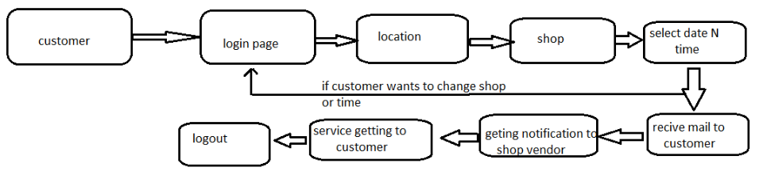
Generalized system Architecture

Slide 7
Description of System
Product functionality:
Online-Barber Shop System provides the features for admin, shop owner and customer. It includes several functionalities describes as below:
Admin Management:
It provides facility to add, update, delete and view the shops. We can view their details and also update the shop details.
Shop Owner Management:
The shop owner can view the list of appointment, can add, update and delete the services, slots, change the status of shop.

Slide 8
Description of System
Booking the appointment:
Customer can select the location from drop box. After selecting the location he can select particular shop. He can select the services that he wants. He can also select multiple services after that he can select the time slot as he prefer and book the appointment.

Slide 9
Applications
E-Barber Shop system is responsible for providing best services, flexible time slot and daily services and time changes with the affordable prices on specified.
The application provides facility to add/remove/slot and services items at shop. It also provides facility where customers can mention their queries/complaints in reviews.

Slide 10
Advantages / Disadvantages
Advantage :
The system allows the customer to book Barber Shop appointment online.
Shop owner can view the list of appointments of customer and also can add, update and delete the services
To fill the communication gap between customer and shop owner.
Disadvantage :
Unable to integrate Payment gateway with system.

Slide 11
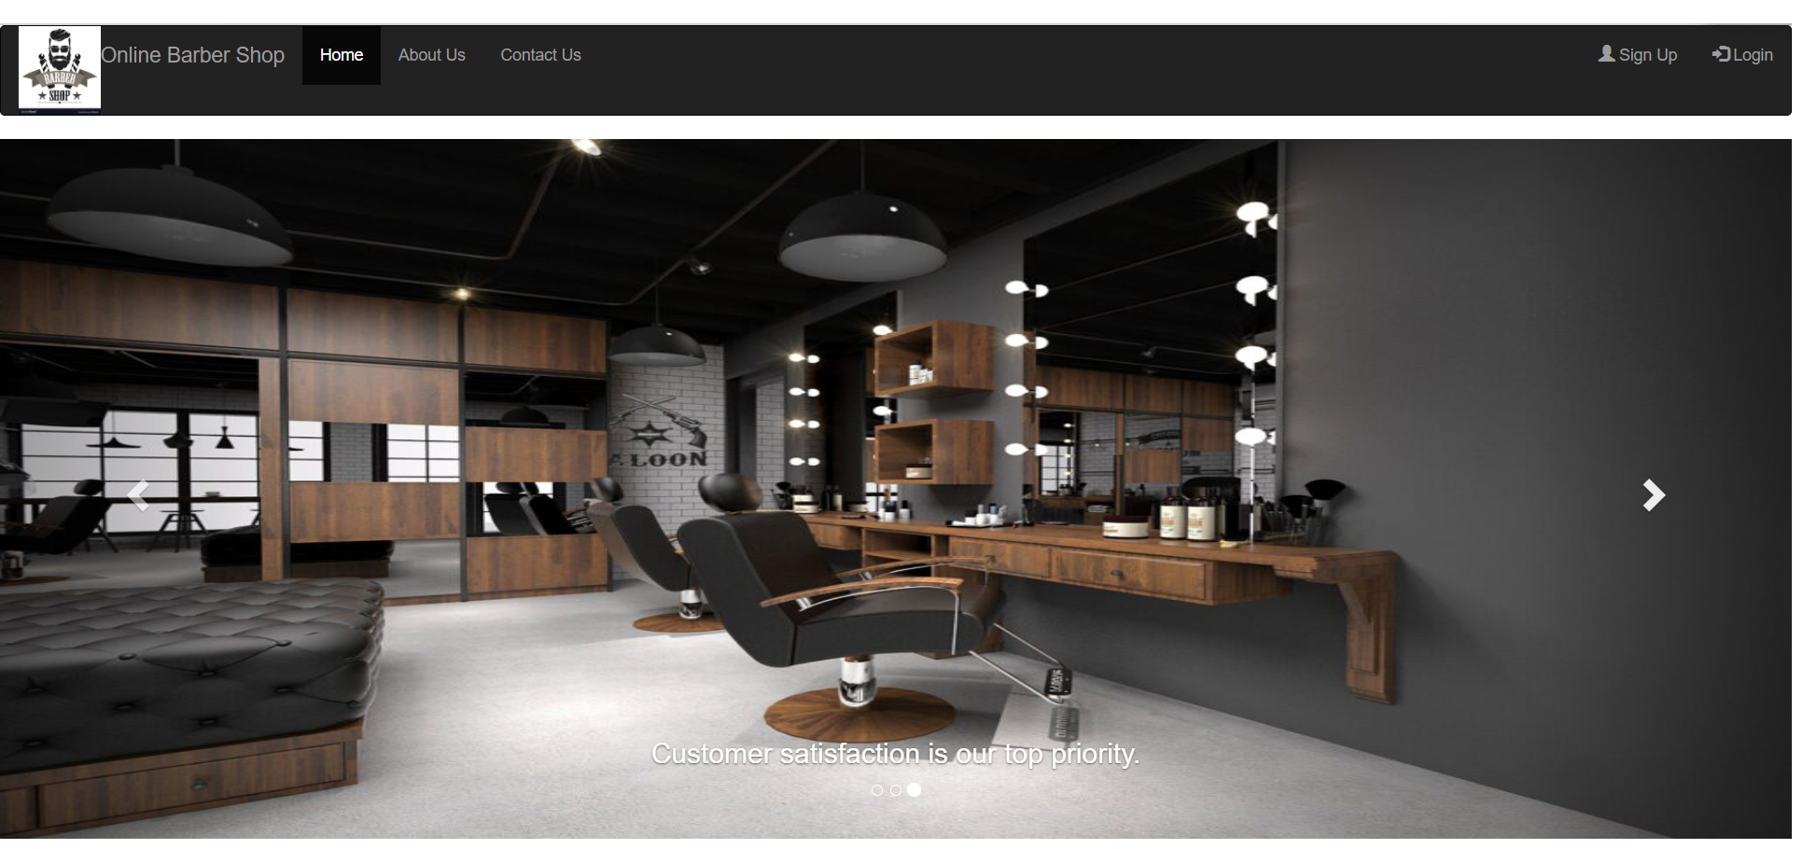
Following are images of working prototype :
Front page:

Slide 12
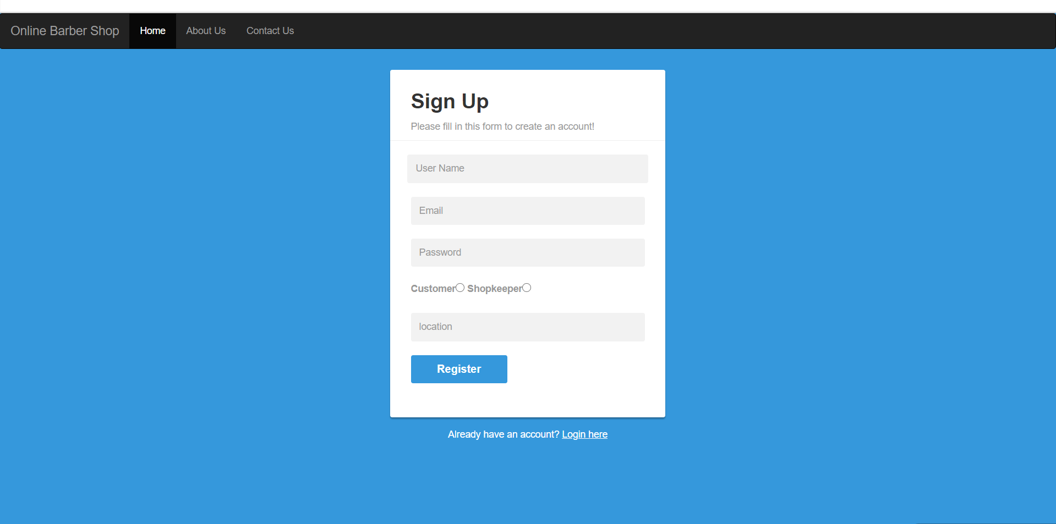
Sign-up page:

Slide 13
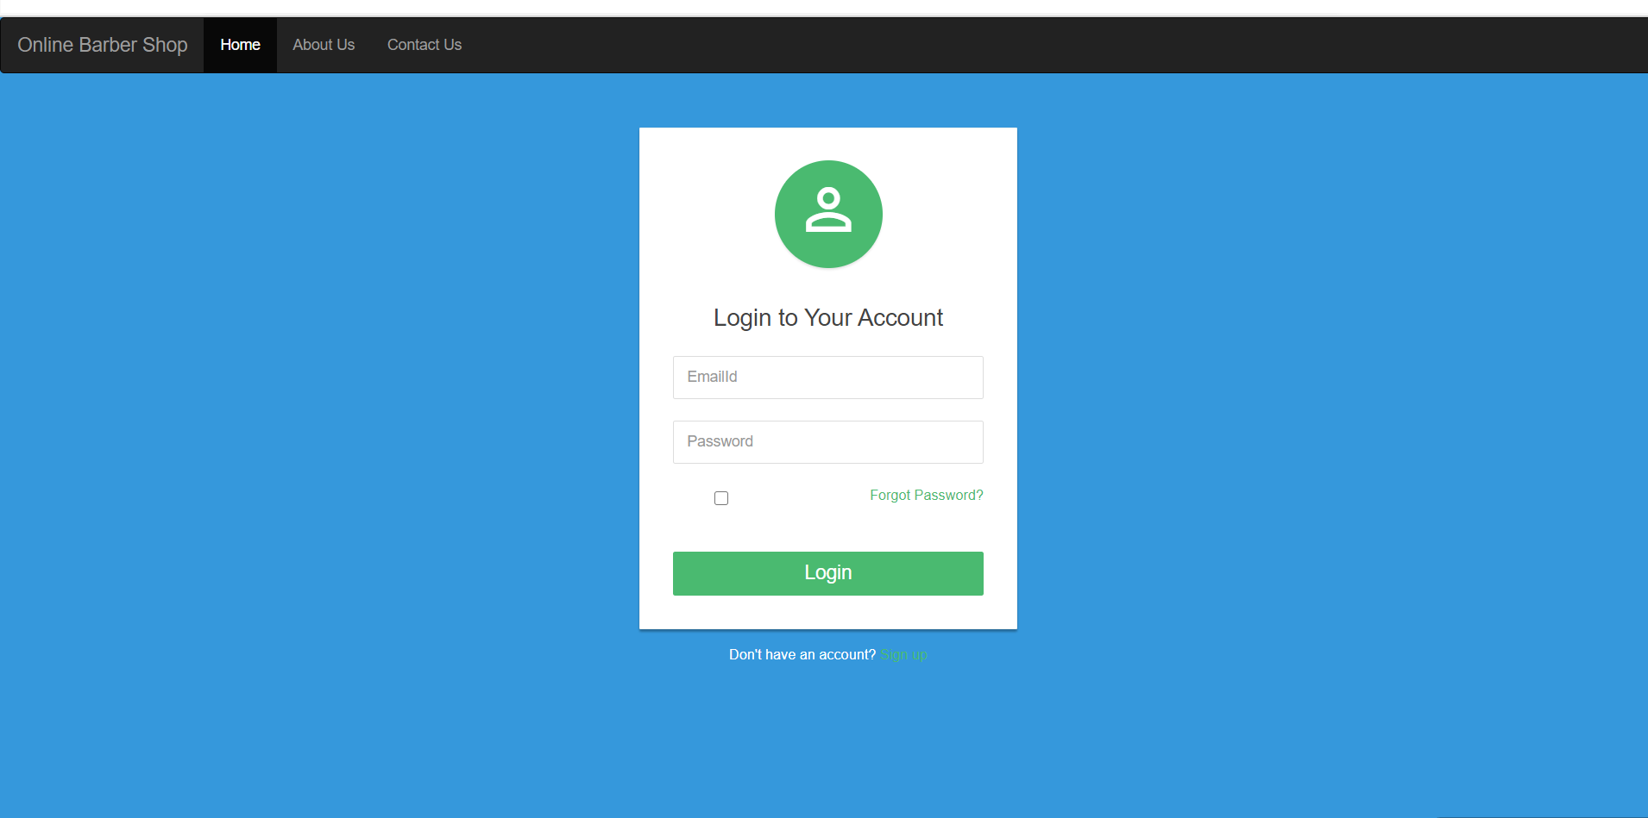
Login page:

Slide 14
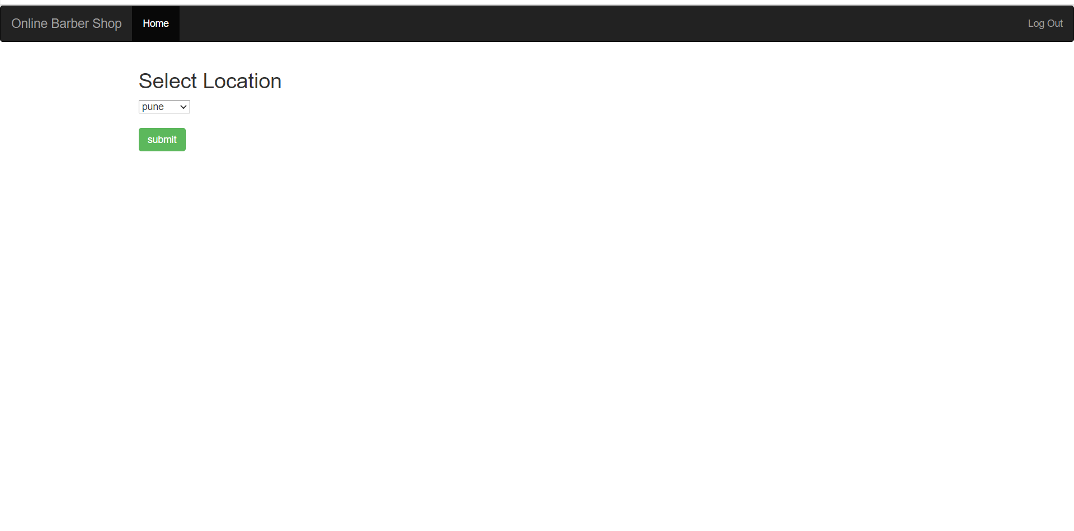
Select Location:

Slide 15
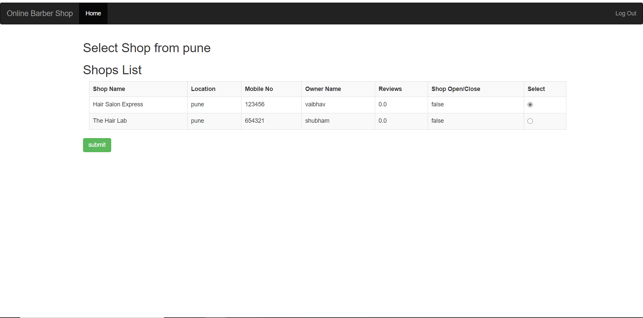
Select Shop:

Slide 16
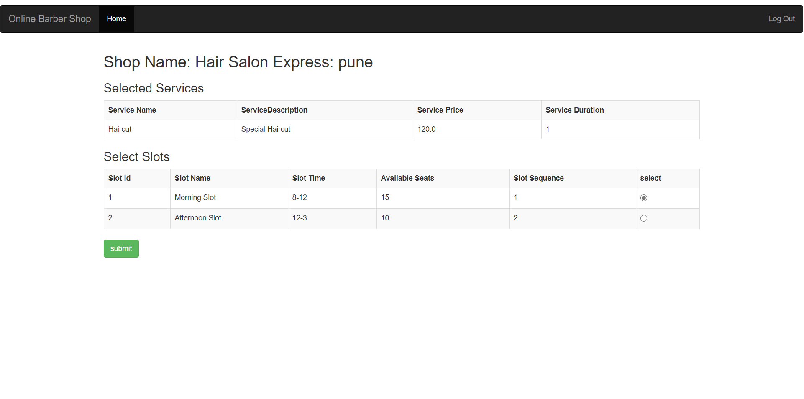
Select Slot:

Slide 17
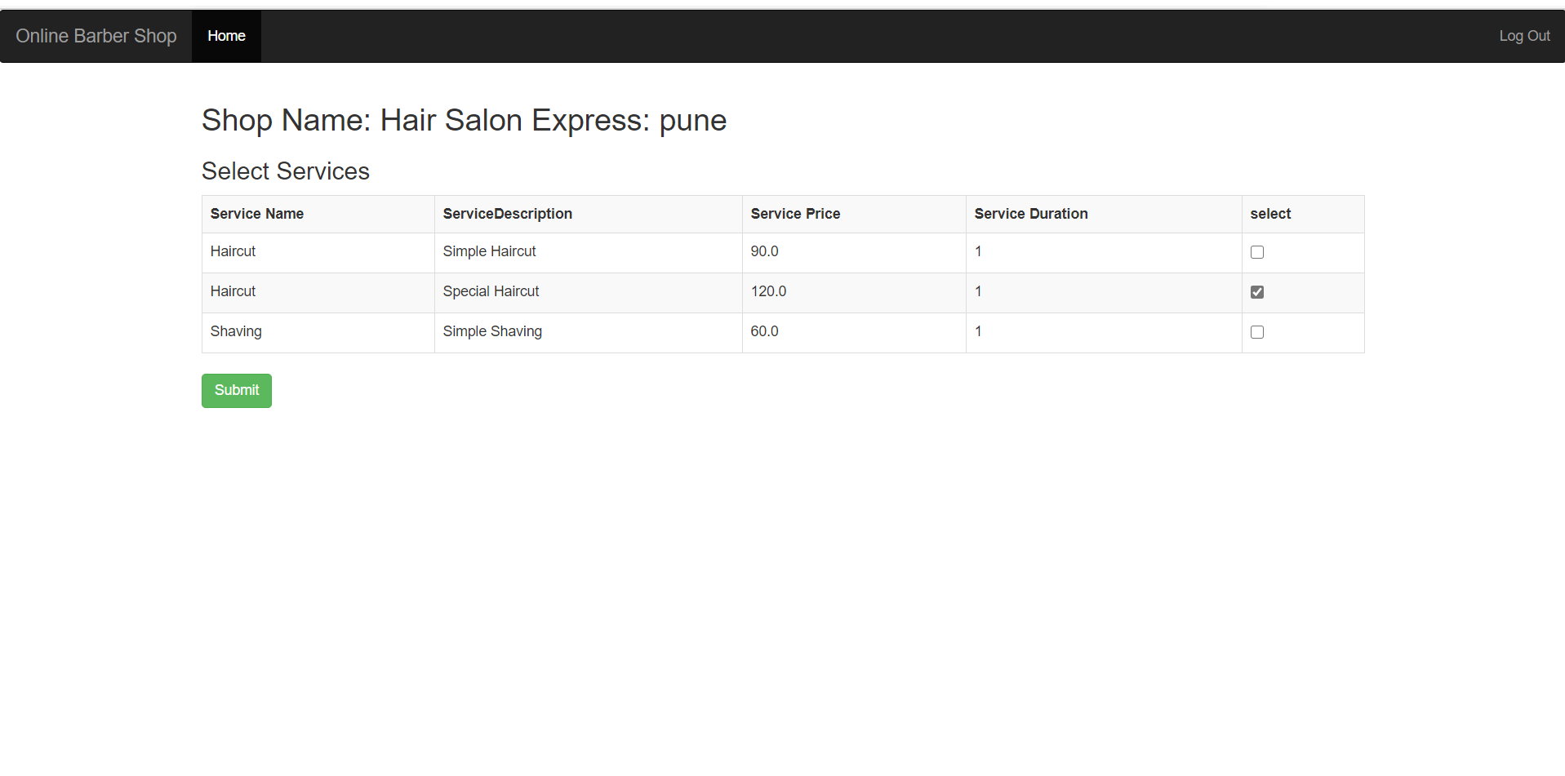
Select Service:

Slide 18
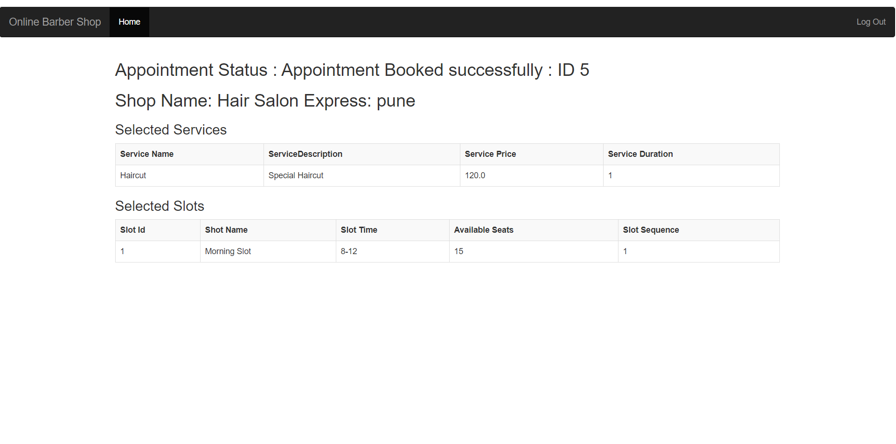
Booking Success Status:

Slide 19
Conclusion
E-Barber Shop system is responsible for providing best services, flexible time slot and daily services and time changes with the affordable prices on specified.
This approach also offers an added advantage that customers can select a specified time slot of the day for the appointments of shop.
The application provides facility to add/remove/slot and services items at shop.
It also provides facility where customers can mention their queries/complaints in reviews.

Slide 20
References
[4] Kirti Bhandge, Tejas Shinde, Dheeraj Ingale, Neeraj Solanki, Reshma Totare,”A Proposed System for Touchpad Based Barber shop System Using Android Application”, International Journal of Advanced Research in Computer Science Technology (IJARCST 2015). .
[5]Varsha Chavan, Priya Jadhav,Snehal Korade,Priyanka Teli, ”Implementing Customizable Online Barber shop System Using Web Based Application”, International Journal of Innovative Science, Engineering Technology(IJISET) 2015.
ONLINE REFERENCES:
www.salonist.in/
https://docs.oracle.com/javase/tutorial/

Slide 21
Thank You!!!

